Slide 1
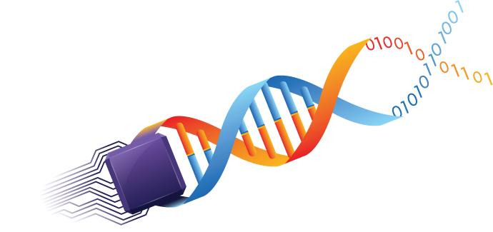
Jingxuan Wu (Eric)

Slide 2

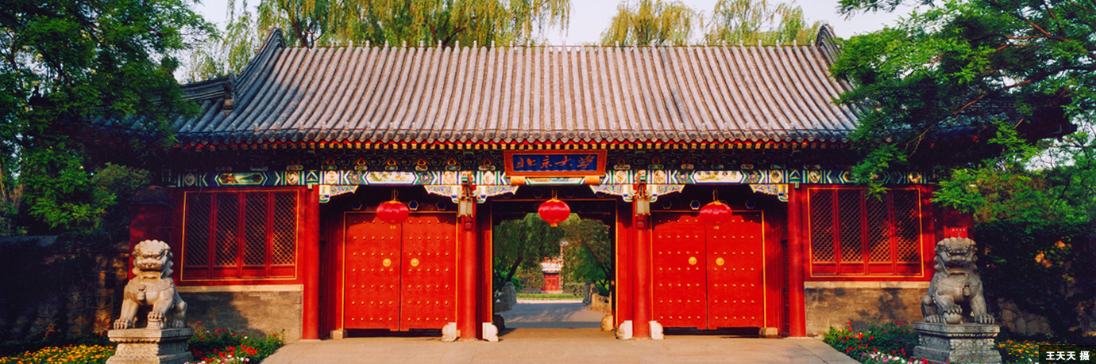

Slide 3
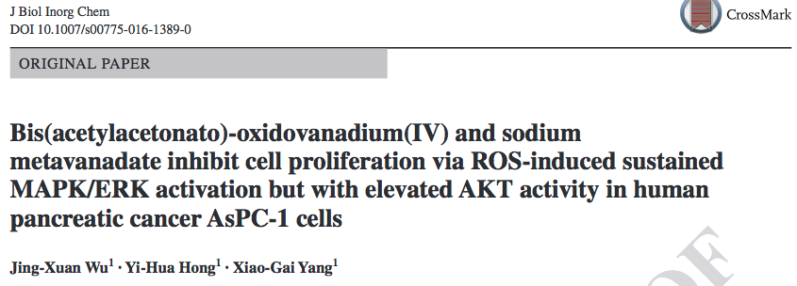
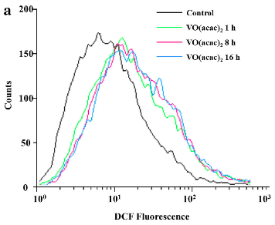
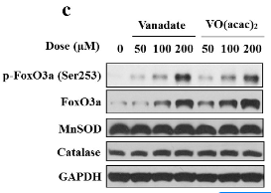
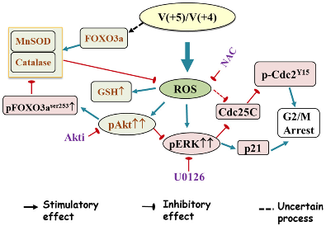
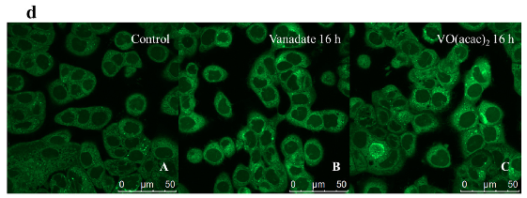

Slide 4
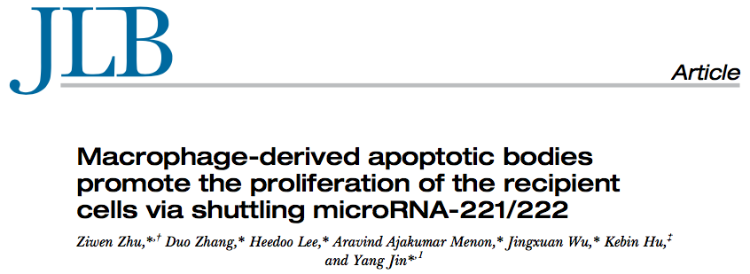
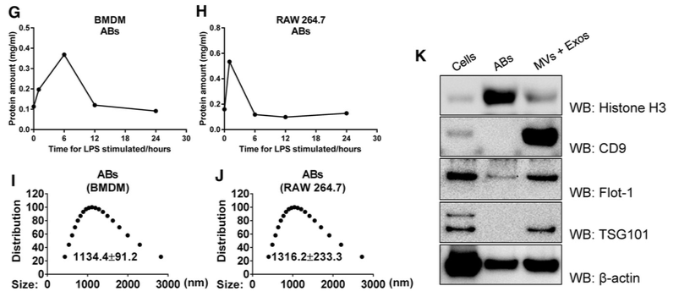

Slide 5
two reasons Why I need a “switch”:
too many repeated works that can (should)
be replaced by machine
too many mechanisms that are lack of application

Slide 6

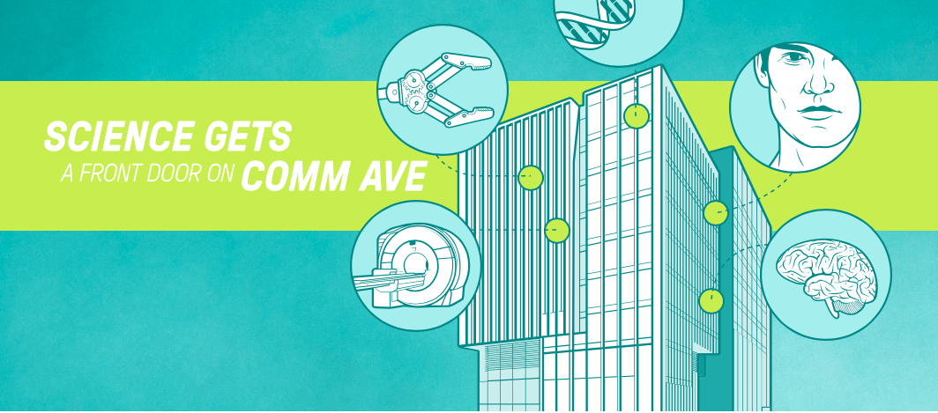
Notes:
Synthetic biology & automation

Slide 7

Why I am here:
the concept: using biological mechanism to help solve problems
the way to realize it: automation
What can I do for our lab:
Cross-disciplinary background
Notes:
My career goal has perfect matched The concept here: using biological mechanism to help solve problems and the way to realize it: automation.

